Slide 1
Triggers
Triggers define code to be executed automatically when a certain event happens. Triggers takes no parameters.
DDL Trigger
CREATE, ALTER, DROP
DML trigger
INSERT, UPDATE, DELETE
Trigger can be set on Server level, Database level and Table level
logon triggers are skipped
Logon triggers fire in response to a LOGON event

Slide 2
Triggers
You need to be familiar with the different types of DDL and DML triggers, but don’t have to dig too deep
Being familiar with the core concepts and knowing how to create basic DDL and DML triggers should be sufficient
Additional topics like logon triggers and different optional settings will not be covered.

Slide 3
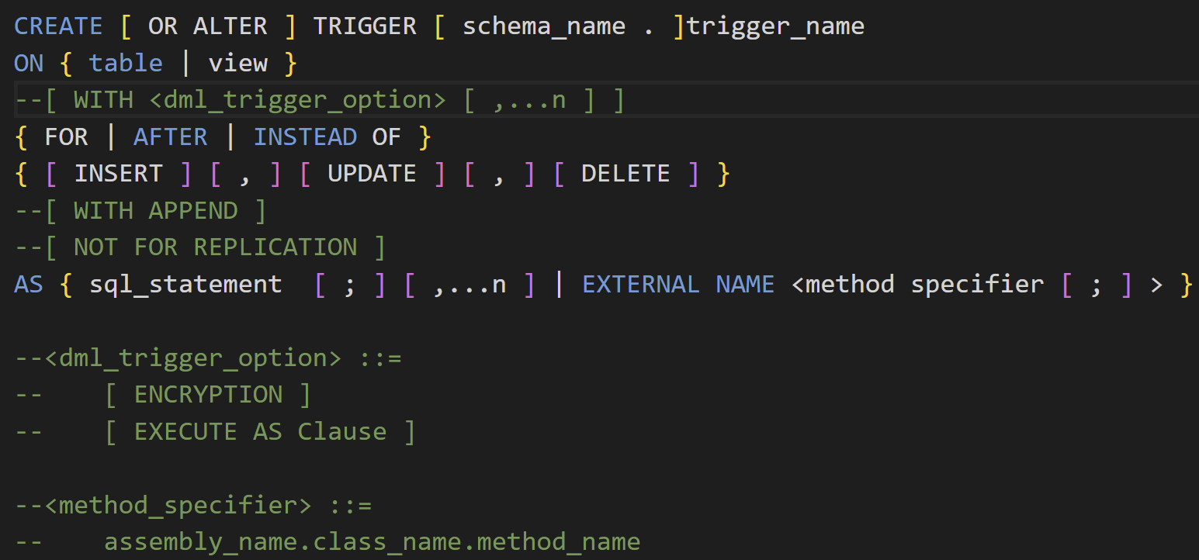
DML Triggers
FOR and AFTER triggers are equivalent

Slide 4
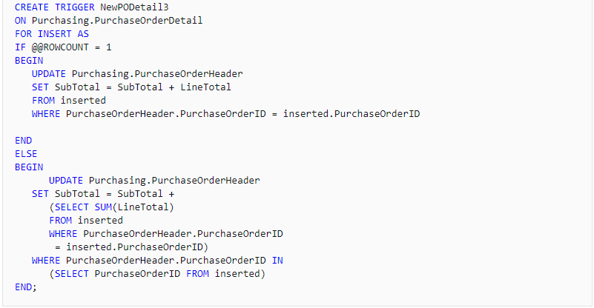
DML Triggers
@@rowcount returns the number of rows affected by the last statement

Slide 5
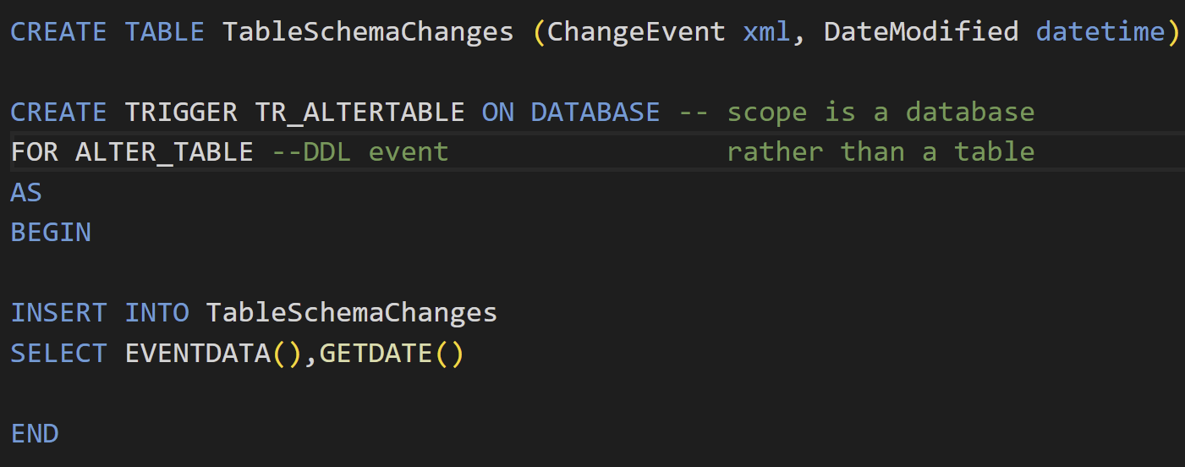
DDL Triggers
Check documentation for different database/server level events

Slide 6
Control Flow

Slide 7
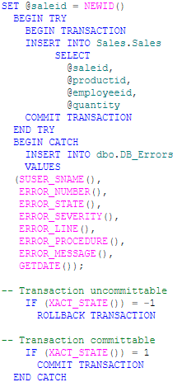
TRY CATCH
Error handling is done by using try catch.

Slide 8
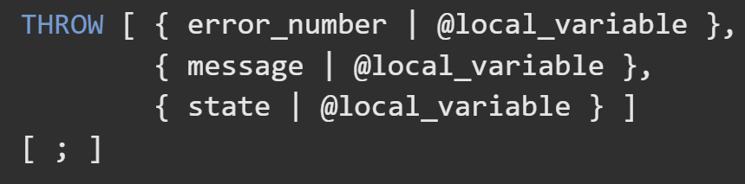
THROW
Used to manually raise an error
often used when database operations are working fine, but violating business rules
meaning of error_number and state are defined by user, error_number needs to be between 50000 and 2147483647, state needs to be between 0 and 255

Slide 9
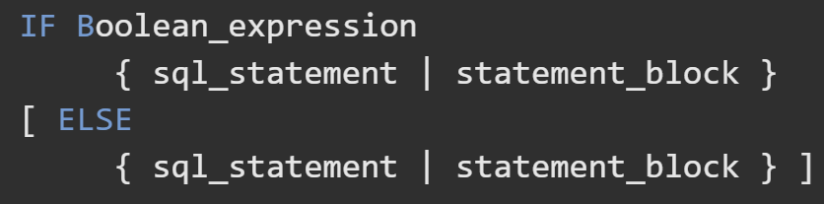
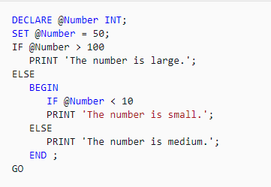
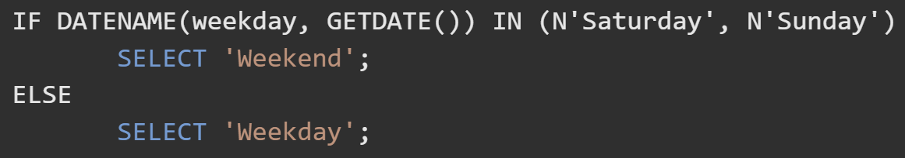
IF ELSE

Slide 10
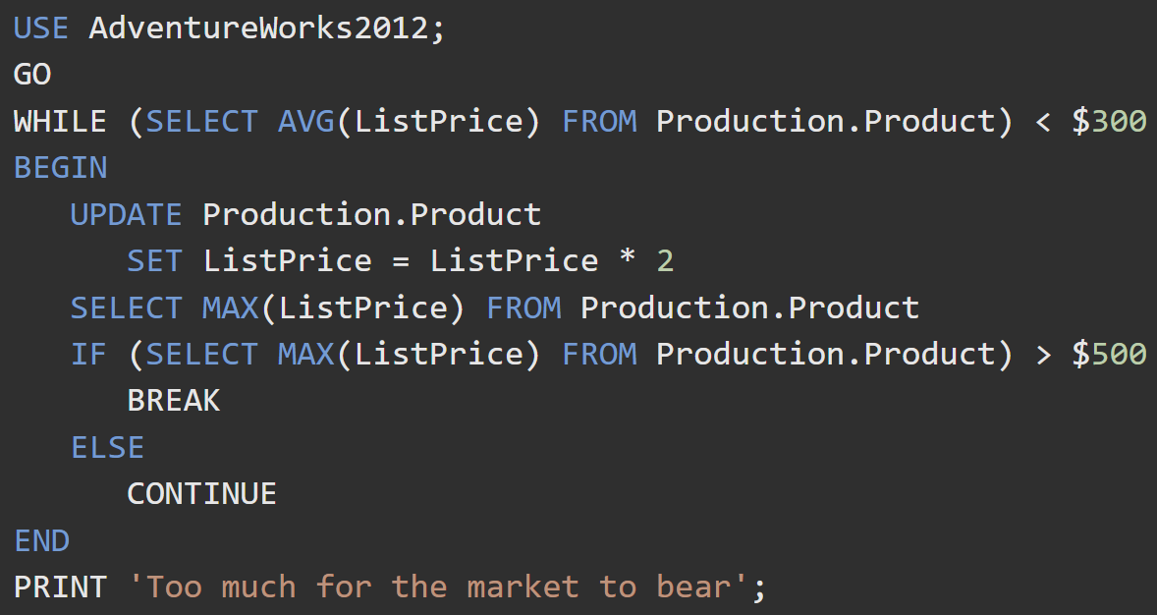
WHILE

Slide 11
BREAK CONTINUE
BREAK
exits the current WHILE loop.
If the current WHILE loop is nested inside another, BREAK exits only the current loop, and control is given to the next statement in the outer loop.
Continue
Skip the current iteration of the loop. Any statements after the CONTINUE keyword are ignored.

Slide 12
Additional Topics

Slide 13
Referential Integrity
NO ACTION
The Database Engine raises an error and the delete or update action on the row in the parent table is rolled back.
CASCADE
Corresponding rows are updated or deleted in the referencing table when that row is updated or deleted in the parent table.
CASCADE cannot be specified if a timestamp column is part of either the foreign key or the referenced key.
ON DELETE CASCADE cannot be specified for a table that has an INSTEAD OF DELETE trigger.
ON UPDATE CASCADE cannot be specified for tables that have INSTEAD OF UPDATE triggers.

Slide 14
Referential Integrity
SET NULL
All the values that make up the foreign key are set to NULL when the corresponding row in the parent table is updated or deleted.
the foreign key columns must be nullable.
Cannot be specified for tables that have INSTEAD OF UPDATE triggers.
SET DEFAULT
All the values that make up the foreign key are set to their default values if the corresponding row in the parent table is updated or deleted.
all foreign key columns must have default definitions. If a column is nullable, and there is no explicit default value set, NULL becomes the implicit default value of the column.
Cannot be specified for tables that have INSTEAD OF UPDATE triggers.

Slide 15
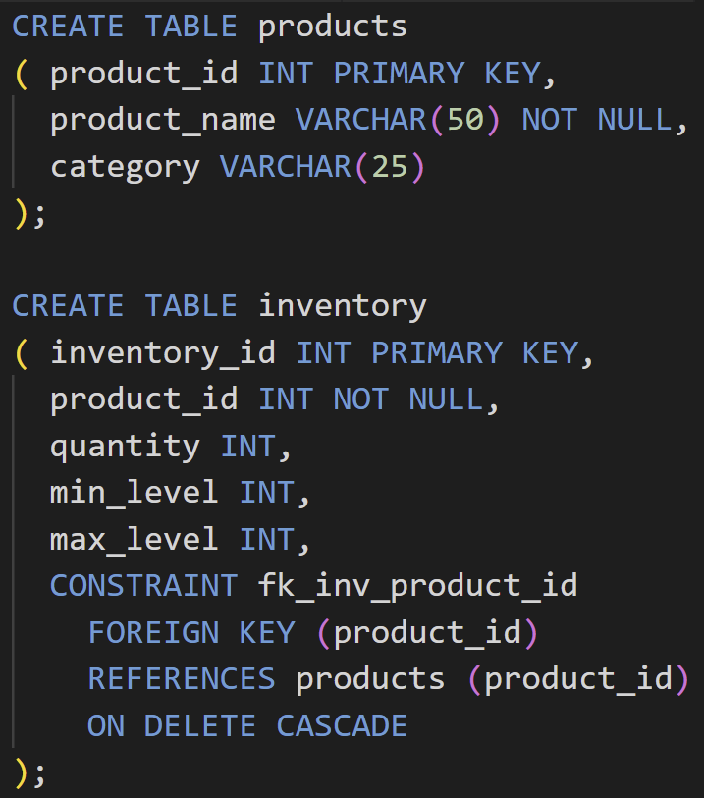
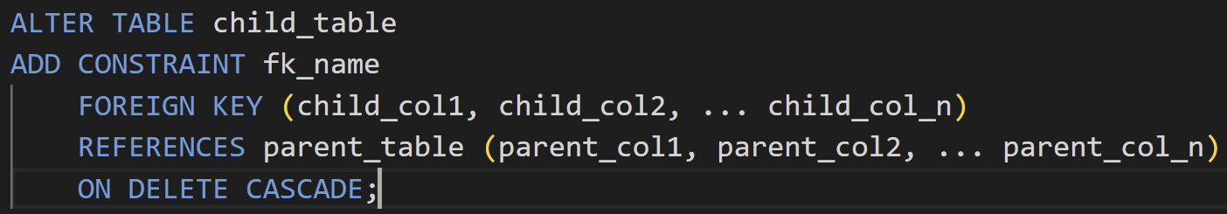
Referential Integrity

Slide 16
Index
Indexes are used to improve read performance. It will increase write time by a little, best for read-heavy tables.
Clustered Indexes are physical indexes to sort and store the data rows. Only 1 clustered index per table. Created automatically for PK
Nonclustered indexes have a key value pairs structure which contains a pointer to the clustered index address. Created automatically for UNIQUE
Can both be unique or non-unique
Index can be created on combinations of columns.

Slide 17
Index
There are a total of 12 types of indexes in SQL Server
For additional information, check https://docs.microsoft.com/en-us/sql/relational-databases/indexes/indexes?view=sql-server-ver15

Slide 18
Finding Missing Index
Locate slow but frequently used queries using Extended Events or Logs, then use EXECUTION PLAN to view any potential index placement.
Use TUNING ADVISOR to automatically locate missing indexes.

Slide 19
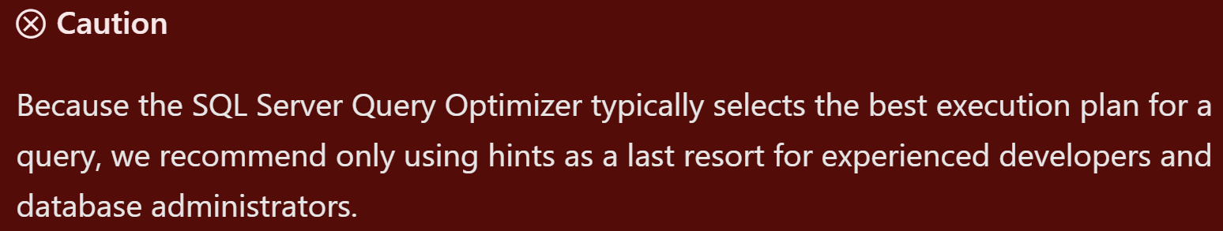
QUERY HINTS
Query Hints are optional commands to tell SQL Server how to execute a particular query.
When Selecting, we can use table hints to apply certain types of locks to a table, including NOLOCK, TABLOCK, ROWLOCK, SNAPSHOT, etc
Hash | Order GROUP BY
Merge | Hash | Concat UNION
Loop | Merge | Hash JOIN

Slide 20
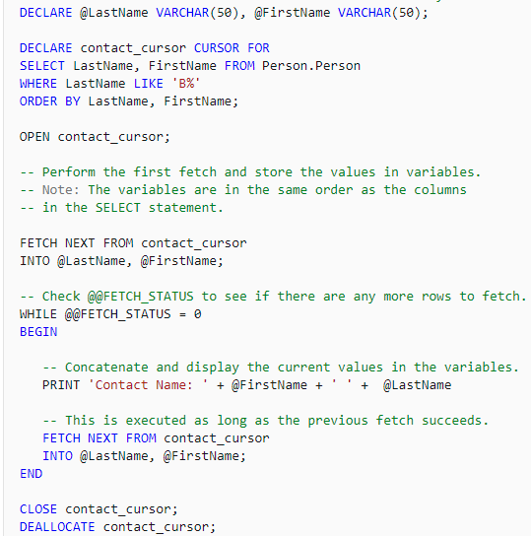
CURSOR
Kind of a for-each loop for each row of a result set
HUGE performance hit, but could be useful in certain scenarios.
ODBC/JDBC might force you to use cursor

Slide 21
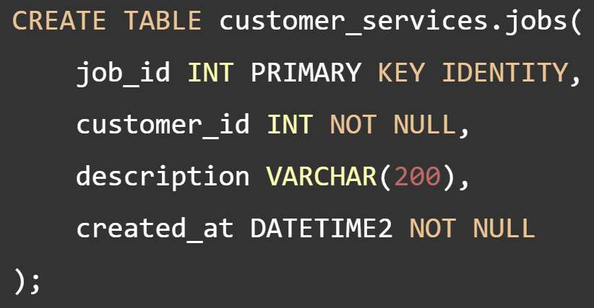
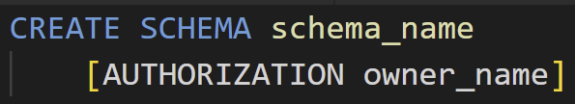
Schema
Collection of database objects
predefined schemas
dbo, guest(guest is rare to see, even the official doc doesn’t talk about it)
sys, and INFORMATION_SCHEMA(no modifications allowed)
Useful for grouping tables, views by business logic.
Useful for permission assignment

Slide 22
SQL Server Agent
Microsoft Windows service that executes scheduled administrative tasks, which are called jobs in SQL Server
Schedule future jobs, execute maintenance plans
https://docs.microsoft.com/en-us/sql/ssms/agent/sql-server-agent?view=sql-server-ver15

